Slide 1
“God Is”
Notes:
Dennis Carrow and Steven J. Wallace

Slide 2
God Is Not
God Is Not A Man (Num. 23:19)
  “God is not a man, that He should lie, Nor a son of man, that He should repent. Has He said, and will He not do? Or has He spoken, and will He not make it good?”
NOT A MAN
Not Lie
Not Repent
Nature of God Versus Man
(Matt. 23:3; Prov. 23:7; Lk. 13:1-3; Deut. 32:4; 2 Sam. 7:8; Ps. 33:4; etc.)
Notes:
You see something here pertaining to the nature of man and God. Man is untrustworthy. He is crooked, conniving, deceitful. Man may elevate the status and worthiness of truth with his mouth and yet at the same time behave in deceit and work with fraud.
What man says he will do, he often does not. What he says he didn’t do, is what he often has done. I’ve learned something about a few individuals that I’ve got to know well these last ten years. What they say is, is actually what is not and what they say is not, is actually closer to what is. What he leads you to believe he did, is actually what he did not. It is a deceptive, cowardly way of doing what the Pharisees did by saying and doing not (Matt. 23:3).
What man says may not be what he feels (Prov. 23:7). What he feels he may not say. Man is called to repent because he is a liar and worker of evil. He is an enemy of God unless he repents (Lk. 13:1-3).
God, however has a character altogether different. He says and does. He speaks and makes it good. He is of truth (Deut. 32:4; 2 Sam. 7:8; Ps. 33:4; 146:6; Rom. 3:4; Heb. 6:18). He doesn’t flip flop (Jas. 1:17). He makes His word good! It is no exaggeration when Jesus said in Luke 21:33, "Heaven and earth will pass away, but My words will by no means pass away.”

Slide 3
God Is Not
God Is Not A Man (Num. 23:19)
  “God is not a man, that He should lie, Nor a son of man, that He should repent. Has He said, and will He not do? Or has He spoken, and will He not make it good?”
MAN
Broken vows
Broken promises
Broken trusts
Broken words

Slide 4
Man Away From God
28 And even as they did not like to retain God in their knowledge, God gave them over to a debased mind, to do those things which are not fitting;
29 being filled with all unrighteousness, sexual immorality, wickedness, covetousness, maliciousness; full of envy, murder, strife, deceit, evil-mindedness; they are whisperers,
30 backbiters, haters of God, violent, proud, boasters, inventors of evil things, disobedient to parents,
31 undiscerning, untrustworthy, unloving, unforgiving, unmerciful (Rom. 1)

Slide 5
God Is Not
God Is Not A Man (Num. 23:19)
God Is Not The God Of The Dead
(Matt. 22:23-32)
God Is Not The Author Of Confusion (1 Cor. 14:33)
Notes:
God is Not the God of the dead
The Sadducees were a sect of the Jews which originated about 260 BC. They rejected the idea of a resurrection and of the existence of spirits and angels (see Acts 23:8). The Sadducees made three fatal errors:
1. They were mistaken concerning the scriptures (i.e. Dan. 12:2; Is. 26:19).
2. They were mistaken concerning the power of God.
3. They were mistaken concerning the nature of the future world. H. Leo Boles wrote
in his commentary on Matthew, “The objection of the Sadducees is without force, since it was
based upon a misunderstanding of conditions. Marriage bears a necessary relation to death, since
it was designed by God to perpetuate the human family; but after the resurrection, there is eternal
life, and no need for the institution of marriage as there will be no death to destroy the being”
(New Testament Commentaries, Gospel Advocate, p. 435).
God is not the author of confusion
The Lord’s worship service is to be peaceful and orderly, not chaotic. When we do
things for God, it should be done “in turn” (v. 27). Wonder if one tries to lead singing the
same time one is trying to lead the Lord’s supper, while one is trying to pray, while I am
trying to preach. That would be mass confusion.

Slide 6
God Is Not
God Is Not A Man (Num. 23:19)
God Is Not The God Of The Dead
(Matt. 22:23-32)
God Is Not The Author Of Confusion (1 Cor. 14:33)
God Is Not Mocked (Gal. 6:7-10)
God Is Not Unrighteous To Forget (Heb. 6:10)
Notes:
God is not mocked:
A. God is not mocked! The Greek word for mock literally means sneer, turn up your nose
at, deride. It is used here in the sense that man thinks he can outfox God.
B. The deception is that Paul warns is thinking that you can live the life of the wicked and
die the death of the righteous.
God is not unrighteous to forget…it would be unrighteous for one to forget your work and labor that you have shown toward them. This goes back to Num. 23:19.
Did God forget Boaz and his kindness to Ruth (2:15)? Would God forget the kindness of those in the land of Tema, “O inhabitants of the land of Tema, Bring water to him who is thirsty; With their bread they met him who fled” (Is. 21:14). The very teaching of the good Samaritan shows that God takes notice of your work and labor of love. Others may not. Others may forget the very kind gestures or deeds you have done, but God will not.
We need to remember that God remembers and that can be a double edged sword. While people may use us, and have little esteem for the work we do, God will not forget. But if you are not in Christ, He will not even recognize you (Matt. 7:21-23).

Slide 7
God Is
BUT…

Slide 8
I know who You are -the Holy One of God!
- Mark 1:24

Slide 9
Jesus I know, and Paul I know; but who are you?”
- Acts 19:15

Slide 10
GOD IS…
HOW DOES ONE
KNOW?

Slide 11
GOD IS…
A Matter of Faith?
A Matter of Fact?
Romans 1:20; 10:17
Notes:
Rom. 1:20, The implication of the supernatural is flows from the natural. The implication of a Creator comes from the creation.

Slide 12
Five Manifestations
of Knowable Truth
Herbert Spencer (1820-1903)
Time
Force
Action
Space
Matter
1
“In the Beginning
God Created
The Heavens and
The Earth”
2
3
4
5

Slide 13

The State of Decay
The laws of mass and energy conservation and deterioration states, that in a closed system in which no energy is being created or destroyed, some of the thermal energy becomes unavailable for work.
Notes:
Note, a “closed system.” A closed system is a system, a universe and its environment, sphere or such that has no input of new energy from without. Yet the law of decay is also present. It is often referred to as entropy. Yet I like how a student defined it in simple practical terms,
“The second law is based on human experience. It doesn’t come from complicated theory and equations. So, think of these experiences that you have had: A rock will fall if you lift it up and then let go. Hot frying pans cool down when taken off the stove. Iron rusts (oxidizes) in the air. Air in a high-pressure tire shoots out from even a small hole in its side to the lower pressure atmosphere. Ice cubes melt in a warm room.
What’s happening in each of those processes? Energy of some kind is changing from being localized ("concentrated" in the rock or the pan, etc.) to becoming more spread out” (http://entropysite.oxy.edu/students_approach.html)

Slide 14
Our Universe
¹ Quantitatively Stable
² Qualitatively Decaying

Slide 15

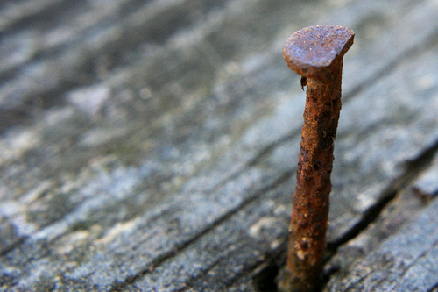
Energy
The march to randomness
O₂
Energy
The bonds become broken as energy is released; randomness ensues

Slide 16
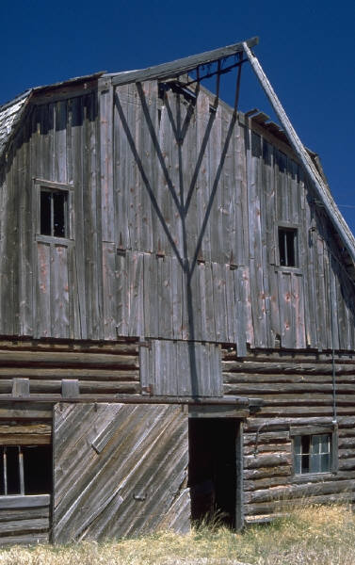
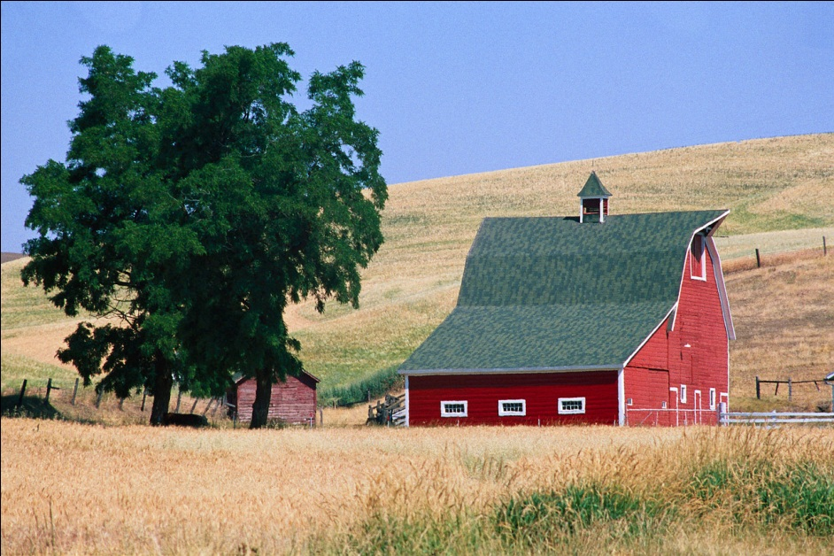
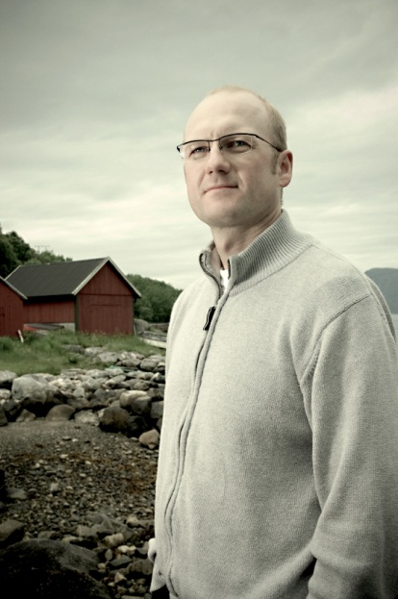
Close System
Effects may be temporarily offset by outside energy
A BARN LEFT TO ITSELF WILL DECAY
energy

Slide 17

“thy works were finished from the foundation of the world.” Hebrews 4:3
“Thus the heavens and earth were finished ...and the seventh day God ended His work.”
        Genesis 2:1,2

Slide 18
God Preserves the System
“You alone are the LORD; You have made heaven, The heaven of heavens, with all their host, The earth and everything on it, The seas and all that is in them, And You preserve them all. The host of heaven worships You” (Neh. 9:6)

Slide 19
God Built In The Law of Decay
Job 13:28 “Man decays like a rotten thing, Like a garment that is moth-eaten.”
Isaiah 51:6, “Lift up your eyes to the heavens, And look on the earth beneath. For the heavens will vanish away like smoke, The earth will grow old like a garment, And those who dwell in it will die in like manner; But My salvation will be forever, And My righteousness will not be abolished.

Slide 20
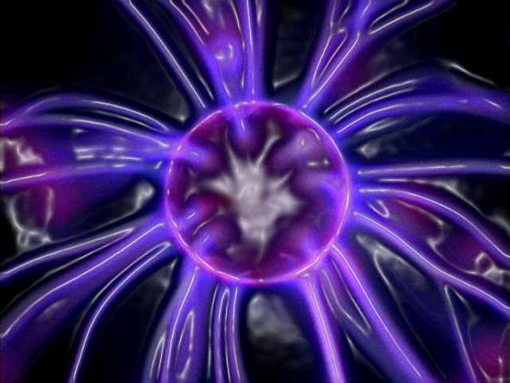
But God is Not Subject To Decay
Hebrews 1:11, 12, “They will perish, but You remain; and they will all grow old like a garment, like a cloak You will fold them up, and they will be changed. But You are the same, and Your years will not fail.”
Notes:
The creator of nature is not subject to nature.

Slide 21
GOD IS…
A Matter of Fact…
  The Heavens Declare…
    GLORY. Psalms 19:1
    RIGHTEOUSNESS. 50:6;97:6

Slide 22
GOD IS…
RIGHT
AND
WRONG
A Matter of Faith…
  The Word Reveals…
    GLORY. Psalms 19:7-11
    RIGHTEOUSNESS. Rom. 1:16

Slide 23
GOD IS…
Made Known…
  The Heavens Declare…
  The Word reveals…
    Romans 1:16-32

Slide 24
“as His divine power has given to us all things that pertain to life and godliness, through the knowledge of Him who called us by glory and virtue”
- 2 Peter 1:3

Slide 25
We
Are
In
Christ
THE REALM OF SPIRITUAL CERTAINTY
Christ
Is
In
Us
Galatians
3:27, 4:19

Slide 26
You
Have
Known
God
THE REALM OF SPIRITUAL CERTAINTY
You
Are
Known By
God
Galatians
4:9

Slide 27
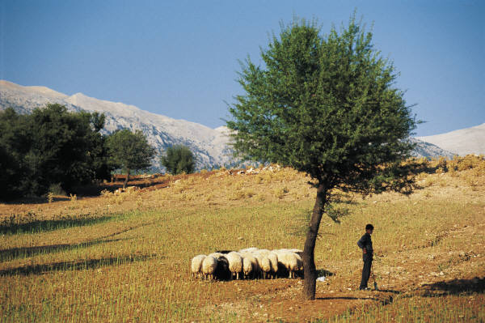
“I Know Him”
My sheep hear My voice, and I know them, and they follow Me.
- John 10:27

Slide 28
“I Know Him”
Many will say… have we not…, but He will say…
“I never knew you” - Matthew 7:21

Slide 29
“I Know Him”
He who says, “I know Him,” and does not keep His commandments, is a liar, and the truth is not in him.
- 1 John 2:4

Slide 30
“the word of God is living and powerful, and sharper than any two-edged sword, piercing even to the division of soul and spirit, and of joints and marrow, and is a discerner of the thoughts and intents of the heart” - Hebrews 4:12

Slide 31
“I know that you do believe.”
“You almost persuade me to become a Christian.”
Acts 26:27

Slide 32
“I know that you do believe.”
“For I know of
nothing against myself,
yet I am not justified by this;
but He who judges
me is the Lord.”
1 Cor. 4:4
Notes:
Read 1cor 4 3-4

Slide 33
“I know that you do believe.”
God Is Spirit…
John 4:24

Slide 34
“I know that you do believe.”
God Is Love…
1 John 4:16

Slide 35
Do you know if you believe?
“He who does not love does not know God, for God is love.”
1 John 4:8

Slide 36
Do you know if you believe?
“whoever keeps His word, truly the love of God is perfected in him. By this we know that we are in Him.”
1 John 2:3

Slide 37
Do you know if you believe?
“By this we know that we love the children of God, when we love God and keep His commandments.”
1 John 5:2
Notes:
Our actions associated with the word are our actions associate with brethren.

Slide 38

GOD IS…
Known…
Draw near to God and He will draw near to you… He will lift you up.
James 4:8
Notes:
If you grab on to a rope and do not see the end but feel the pull of the rope, you would know something is on the other end whether you can see it or not. God wants us to draw near to Him and provides us opportunities to grab the rope, so to speak and draw nearer to Him.

Slide 39
GOD IS…
Made Known…
No one has seen God at any time. If we love one another, God abides in us, and His love has been perfected in us. By this we know that we abide in Him, and He in us, because He has given us of His Spirit.
1 John 4:12

Slide 40
For this reason I also suffer these things; nevertheless I am not ashamed, for I know whom I have believed and am persuaded that He is able to keep what I have committed to Him until that Day.
- 2 Tim. 1:12
Notes:
Yellow - When we Suffer preaching and teaching context 2 Tim. 1:11, we can not be overburdened with sorrow (cf. Col. 1:24).
Orange – We need not be ashamed of the gospel we teach or of the Christ who gave it but are actually being like Christ when we suffer. We have no need to feel shame when we are persecuted for what is right. Christ is being revealed in us and through our example (cf. Rom. 1:16; 9:33; Phil. 1:20, 21)
Green – I know whom I have believed. We know who we trust and there is none better to trust.
Blue – He will keep the soul.
“A man has nothing of higher value to intrust to another than the interest of his soul, and there is no other act of confidence like that in which he intrusts the keeping of that soul to the Son of God. Learn hence,
(1.) that religion consists in committing the soul to the care of the Lord Jesus; because
(a) we feel that we cannot secure its salvation ourselves;
(b) it is by nature in danger;
(c) if not saved by him, it will not be saved at all.
(2.) That is a great and invaluable treasure which is committed to him.
(a) No higher treasure can be committed to another;
(b) in connection with that the whole question of our happiness on earth and in heaven is intrusted to him, and all depends on his fidelity.
(3.)….. The grounds of this confidence are
(a) what is said of the mighty power of the Saviour;
(b) his promises that he will keep all who confide in him, (comp. #Joh 10:27-29;)
(c) experience — the fact that those who have trusted in him have found that he is able to keep them.
(4.) This act of committing the soul, with all its interests, to the Saviour, is the true source of peace in the trials of life. This is so because
(a) having done this, we feel that our great interests are secure. If the soul is safe, why need we be disturbed by the loss of health, or property, or other temporal comforts. Those are secondary things. A man who is shipwrecked, and who sees his son or daughter safe with him on the shore, will be little concerned that a casket of jewels fell overboard — however valuable it might be.
(b) All those trials will soon pass away, and he will be safe in heaven.
(c) These very things may further the great object — the salvation of the soul. A man’s great interests may be more safe when in a prison than when in a palace; on a pallet of straw than on a bed of down; when constrained to say, "Give us this day our daily bread," than when encompassed with the wealth of Croesus” (Albert Barnes).

Slide 42
Do You Know My Jesus?

